Slide 1

Unnamed Perspective Platformer
Steve Berthiaume

Slide 2
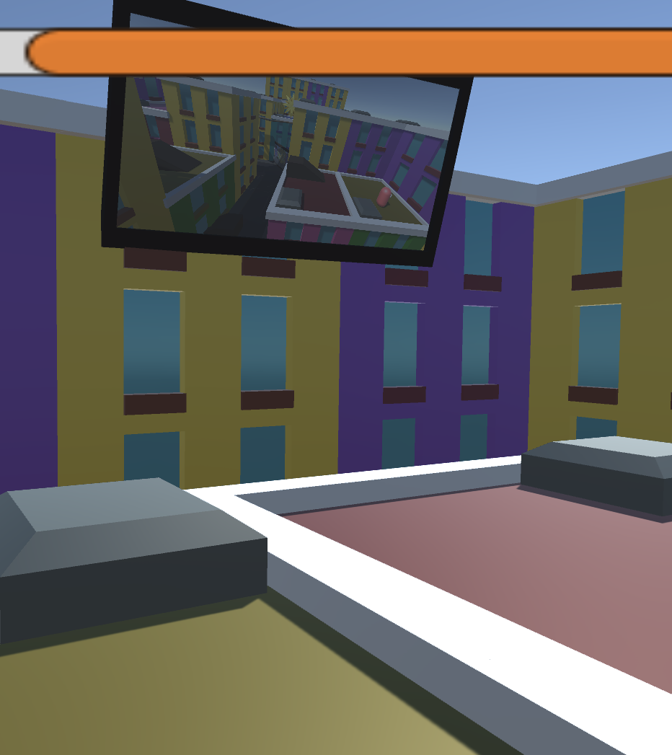
WHAT IS THE GAME?
The game I made is an experiment with camera angles and mirrors – exploring what I’d call a “Perspective” platformer in which the camera angle is out of the player’s control and an active component for the game’s challenge.

Slide 3
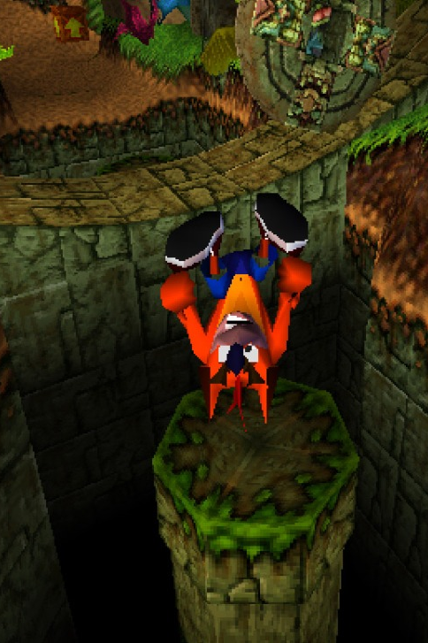
WHAT’S SO SPECIAL ABOUT CAMERAS?
For many decades, platformers of all sorts have explored various subgenres and playstyles, though nearly all 3D forms utilize player-controlled cameras. Very few franchises are exceptions, with Crash Bandicoot being the most noteworthy one.

Slide 4
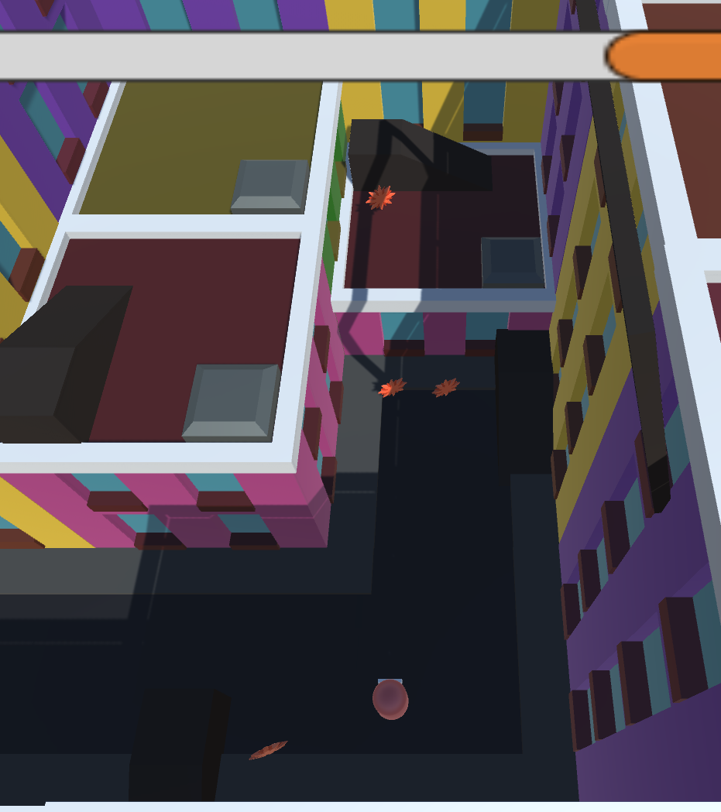
HOW DOES IT WORK?
Unnamed Perspective Platformer currently uses a timer representing the remaining daylight as a lose condition. Failure to reach the end before it drains is a loss, with Sun pickups being scattered as one-time refills across the level, rewarding forward progress.

Slide 5

GAMEPLAY

Slide 6
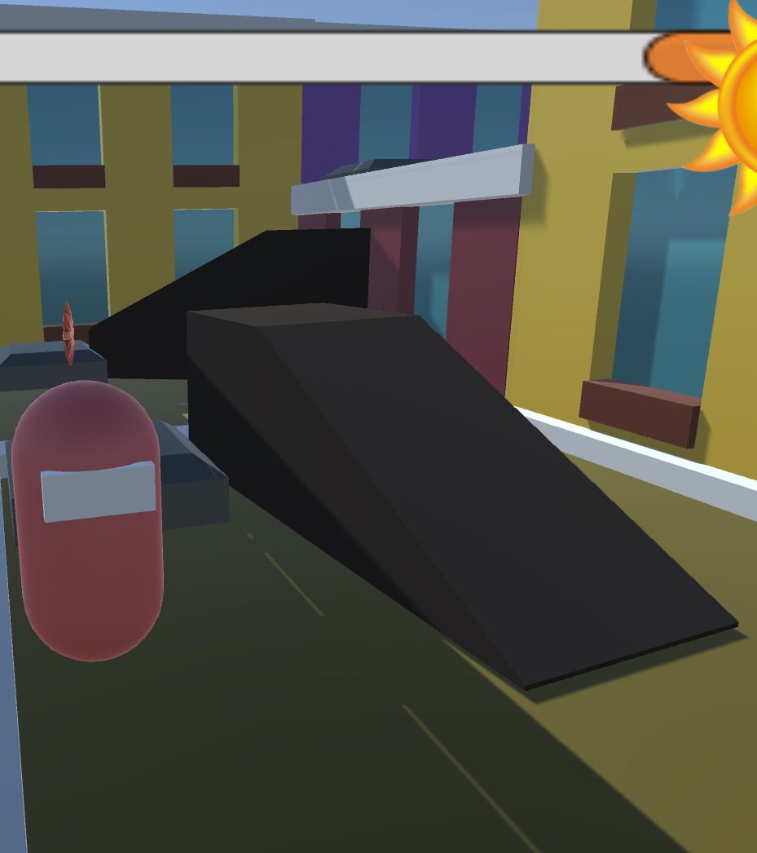
ISSUES
Since this is my first time working with Unity3D, I encountered a few issues along the way, with the most noteworthy one being the movement system’s Jump. Its general unreliability with resetting has made it necessary to lay slopes to be used instead.

Slide 7
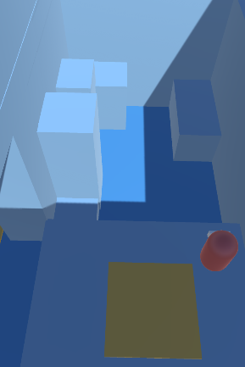
TIME CONSTRAINTS
This semester, I took four other classes concurrently to this one, with these final weeks being predictably hectic and demanding. This project didn’t get to progress quite as much as I’d like as a result. Much of the project’s development came within the past few weeks.

Slide 8
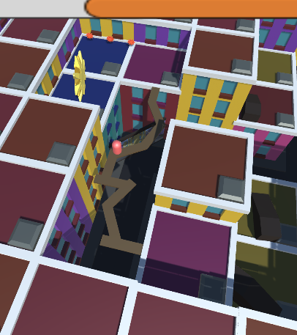
FINDINGS
Experimenting with camera angles and the means of viewing a 3D platformer has made it apparent that a full game exploring this concept would hold quite a bit of potential – serving as a conceptual exploration which defies conventions and expectations of the genre.

Slide 9
THANK YOU!

Slide 10
QUESTION TIME
Given the proper time and care, can you picture the prospect of a “perspective” platformer making for an interesting game experience or exploration of mechanics?

